Slide 1
⛓
GP_42
AttendChain
Blockchain-Based Anti-Proxy Attendance System
Attendance that can’t be faked, edited, or deleted.
TEAM · GP_42
EG/2021/4392 A. N. Akarshana
EG/2021/4385 Adeesha M. G. P
EG/2021/4602 Karunarathne S. M. G. S
EG/2021/4794 Sellahewa I. A
Built with Ethereum · Solidity · Hardhat · ethers.js

Slide 2
THE PROBLEM
Attendance is easy to cheat
Attendance is recorded on paper registers or apps controlled by a single authority. That creates three weaknesses — and no way to prove the record is honest:
Proxy sign-ins
!
A present student signs in for an absent friend. Registers can’t detect it.
THE CORE ISSUE
Editable records
The record is only as
trustworthy as whoever
holds it.
!
A paper sheet or central database can be altered after class, with no trace.
No real proof
!
It can be quietly changed — or completely invented — and no one can tell.
Students and examiners must simply trust whoever keeps the data.

Slide 3
WHY BLOCKCHAIN
Trust the math, not the middleman
1
2
3
4
Immutable
Identity by key
Transparent
No super-admin
Once written to a block, a record can’t be edited or deleted. Blocks are hash-linked, so any tampering is instantly detectable.
Every action is signed with a private key. The signer’s address is the identity — impossible to forge without that key.
Anyone can read the chain and verify the records themselves. There is no hidden, editable database.
The contract’s rules bind everyone — even the deployer. No one can silently rewrite history.
These four properties are exactly what a trustworthy attendance record needs.

Slide 4
THE SOLUTION
Four roles, one simple flow
1
2
3
4
→
→
→
Admin
Teacher
Student
Anyone
Enrols each student, binding their name and roll number to their own blockchain wallet.
Opens a class session for a course, and closes it when the class ends.
Marks their own attendance from their own wallet while the session is open.
Reads the chain to verify exactly who attended — tamper-proof, no login needed.
The key move: a student can only ever mark themselves — the contract credits the transaction signer, never anyone else.

Slide 5
UNDER THE HOOD
What happens when a student marks
1
Sign
The student clicks “Mark present.” Their wallet signs a transaction with its private key.
2
Send
The signed transaction is sent to the AttendChain smart contract. The student is the msg.sender.
3
Check
The contract runs its guards: is the caller registered? is the session open? not already marked?
4
Commit
If all checks pass, the record is written, an AttendanceMarked event is emitted, and it’s mined into a block.
5
Reject
If any check fails, the whole transaction reverts — nothing is written, no half-updates.
Because identity is the signer (msg.sender), there is no field to “mark someone else” — proxy attendance is impossible by design.

Slide 6
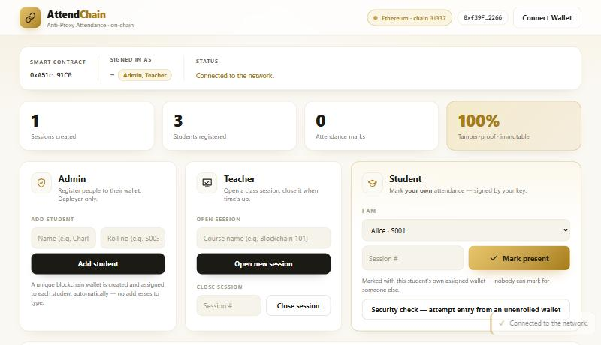
THE PRODUCT
A real, working dApp
✓
Connects to the Ethereum network automatically on load
✓
Admin adds a student with just a name + roll no — a wallet is assigned for them
✓
Each student marks by name; the mark is signed by that student’s own wallet
✓
A live class roster and per-session attendee list, with wallets and timestamps
✓
Anyone can verify a session — no login, fully transparent

Slide 7
SECURITY ASSESSMENT
Every attack, blocked on-chain
✓
Outsider marks attendance → “Not a registered student”
7 / 7
✓
Proxy — mark a friend → only the signer is credited
✓
Self-enrol (privilege escalation) → “Only admin”
real attacks rejected
✓
Open a session as attacker → “Only a teacher”
Each attack is a real signed transaction, blocked by the contract’s require guards — not by trust.
✓
Double-marking / replay → “Already marked”
✓
Back-dating after class closes → “Session is closed”
✓
Tamper / delete a record → no such function exists

Slide 8
ARCHITECTURE
How the pieces fit together
Web UI
Wallet
Smart Contract
Ethereum
The interface, built with HTML and ethers.js. Turns clicks into requests.
→
Signs each action with the user’s private key — this is their identity.
→
AttendChain.sol on the EVM. Holds the data and enforces every rule.
→
The blockchain network that stores each record permanently.
Every action in the interface becomes a signed transaction — the contract enforces the rules, and the chain keeps the proof forever.

Slide 9
THE SMART CONTRACT
AttendChain.sol — inside the code
Data & roles
Key functions
•
students — mapping(address → Student{name, roll})
registerStudent()
enrol a student · onlyAdmin
•
sessions — array of Session{course, open, count}
createSession()
open a class · onlyTeacher
•
marked — per session, per student (one mark)
closeSession()
lock a class · teacher/admin
•
Roles: admin (deployer), teachers, students
markAttendance()
student marks self (msg.sender)
•
Modifiers: onlyAdmin, onlyTeacher
getAttendees() / isPresent()
read-only verification (free)
Events emitted for every change: StudentRegistered · SessionCreated · SessionClosed · AttendanceMarked

Slide 10
RESULTS
Built, tested, and verified
15 / 15
7 / 7
4
100%
automated tests passing
security attacks blocked
guarantees enforced in code
records immutable on-chain
Four guarantees, enforced by the contract:
✓ No proxy marking ✓ No double-marking ✓ No back-dating ✓ No tampering

Slide 11
IN SUMMARY
Trustless attendance,
by design.
✓
Proxy, double-marking, back-dating and tampering — all prevented on-chain
✓
No central authority to trust: the rules are the smart contract itself
✓
Working end-to-end — Solidity contract, web app, 15 tests, 7/7 security-tested
GP_42 · A.N. Akarshana · Adeesha M.G.P · Karunarathne S.M.G.S · Sellahewa I.A
github.com/Nimesh-Aka/GP_42-AttendChain

